Slide 1

Famous Restaurants
Near which European landmark can you get the the greatest income for restaurant development at the cheapest cost. Development of a quick visual indicator.

Slide 2

Introduction
Primary Goal
Provide visual feedback on European landmarks clustered by both likely income (price/rating) and cost (rent, cost of living).
Why ?
Identify both clusters of ‘likely’ and lidentify andmarks who ‘move’ clusters when socio-economic information is included (suggesting they are on the ‘tipping point’). This in turn can be used to maximise investment in areas in high return (high price/popularity) and low cost (low cost of living indicators).
How ?
Clustering of landmarks and identify landmarks who ‘move’ clusters when socio-economic information is included, visually comparing.

Slide 3

Audience
In general the data provided here can be used as a starting point to indicate the likely viability and profit margins for tourist related services in proximity to well known landmarks. More specifically -
Individual Outlet owners
Any individual looking to open for example a restaurant can get quick feedback on the locations that are likely to generate a high income but may present a lower cost base.
International Service Providers
Larger corporates, who either provide directly for customers or who serve the businesses that do so, can also get a feel for likely target locations.
Travel companies
Where there is a disparity between landmark price and popularity and city economics, this may also be used as an indicator for Travel companies that better value is available for their customers at a small distance from the landmark. This is information they could both use for booking hotels (for example) and pass on to their customers for selecting restaurants.

Slide 4

Approaching the problem in detail
Landmark Analysis : Information on the venues (price and rating) near landmarks can be used to give a strong initial indicator as to income opportunities around the landmark
Adding socio-economic factors : What is less clear is the degree to which the resultant clustering is a purely related to the Landmarks in question (i.e. this is just an expensive area) or is actually a factor of the socio-economics of the area in which it is located.
Performing a comparison : In order to give a simple but effective visualisation, the landmarks will be clustered twice
Once with just the neighbouring venue information
A second time with city socio-economic indicators included
Viewing the results : The clustering and the degree to which the clustering changes, will give a quick visual indicator as to the strength of the socio-economic effects. Landmarks around which prices and ratings are high, but economic indicators are low, could present significant investment opportunities.

Slide 5
Data
Relevant data is retrieved from multiple sources.

Slide 6

Landmarks
Popular landmarks chosen, are located throughout Europe
These are manually selected and assembled into a suitable .csv file for loading into Pandas
The criteria for selection are that all are located in a major city, as this in turn ensures -
Socio-economic data is likely to be available
FourSquare venue information is likely to be available (as there are likely to be venues in the vicinity)
The data required for each landmark is
Name – for display
City – for retrieveal of corresponding socio-economic data
Latitude and Longitude – for FourSquare API usage

Slide 7

Venues
Venue information is retrieved via the FourSquare API. Two API calls are available and worth
/explore – this is used to return
A list enues of a specific category (in this case ‘food’)
Some details of this venue (from which we can specifically check for ‘Restaurant’ type)
Can be limited to within a radius of a given latitude and longitude
/venue – this is used to return
Details of a specific venue
Some recommendation information
Price tier and rating average
Notes
Price and rating is unavailable from the /explore API, hence the requirement for the second call
This means a large number of API calls will need to be made
See caching requirement later on how we need to deal with this

Slide 8

City economic information
Europa
Many data sets are available free at http://data.europa.eu
These are often incomplete/sparse and limited however
So, though considered these will not be used
Numbeo
Numbeo offer free data via a browser, but charge for their API
So data instead is scraped manually and downloaded as required.
Specifically the data includes (of interest to us)
Cost of living indicators
City
Cost of Living Index
Rent Index
Restaurant Price index
Salary indicators
City
Salary

Slide 9
Methodology
What approaches were used and why.

Slide 10


Data Exploration Which Landmarks
As discussed earlier landmarks chosen, are located throughout Europe, manually selected and assembled into a suitable .csv file for loading into Pandas. They are also all located in a major city, to ensure availability of economic and foursquare information.
The data required for each landmark is
Name – for display
City – for retrieveal of corresponding socio-economic data
Latitude and Longitude – for FourSquare API usage
Analysis : A simple count of foursquare explore information was done to make sure that sufficient data was available to create appropriate averages. A quick mapping was also done
Discovery : Mapping shows only one of a number of landmarks in a given city.
Action : None for now – we will address this again in diving on results.

Slide 11
Data Exploration Determining likelihood of restaurant success
As an initial goal it was proposed that the best generic indicator for success of any service (but especially restaurants !) in the area of a given European Landmark, would be the success of current restaurants already in this area.
This lead to a few questions –
Which restaurants do we use to analyse ?
What specific information do we use ?
In order to answer these, we proposed –
The restaurants chosen should be those ‘near’ to the landmark. We defiend ‘near as roughly half the distance between our two closest landmarks : Big Ben and Buckingham palace -500m approx.
We needed first to see what information was available . . .

Slide 12
Data Exploration Determining likelihood of restaurant success
The FourSquare API for /explore gave us restaurants but analysis provided only basic indicators, so the /venue API response for multiple retaurants was reviewed to see what was consistently available
This lead to the choice of
Price tier – as an indicator of potential income
Rating – as an indicator od demand and appreciation
Discovery : The /venue API was a premium API (only 50 calls per day!)
Action : A Caching mechanism was created to prevent repeat querying any API, building up data over time.
{
. . .
"venue": {
"price": {
"tier": 2,
"message": "Moderate",
"currency": "\u20ac"
},
. . .
"rating": 8.1,
},
. . .
}

Slide 13
Data Exploration City Economic Indicators
Considerable time was spent on http://data.europa.eu in order to garner relevant open data.
However the data appears to be an aggregation of open data from participant members, and although it has the advantage of time series data that could be used to show progression, it was too sparse for our purposes.
Discovery : The open data is too sparse
Action : Look elsewhere !

Slide 14
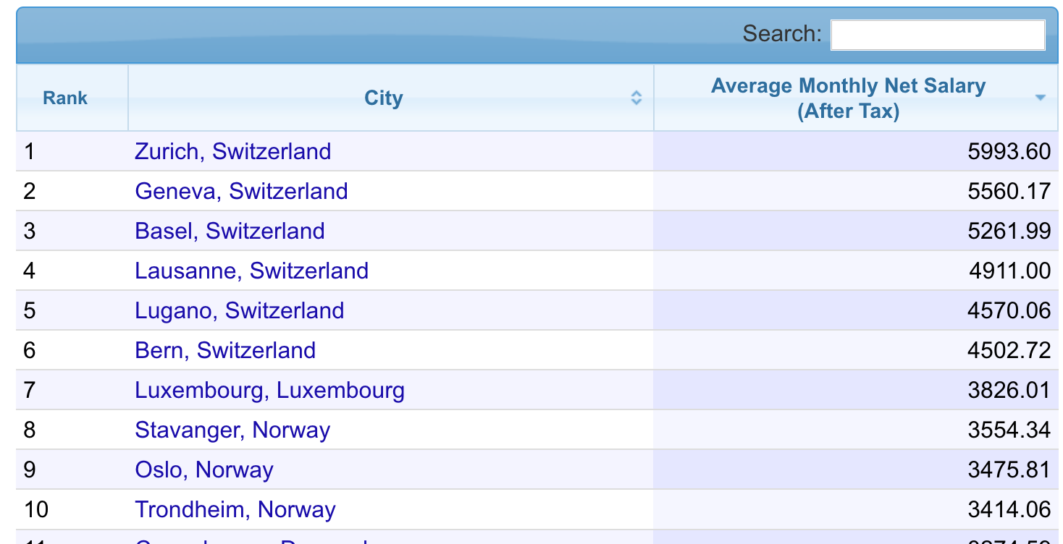
Data Exploration City Economic Indicators
Reviewing multiple sites Numbeo appeared a likely target. They offer free data via a browser, but charge for their API.
As the data can easily be converted to .csv using a browser, this was done and the results stored for use (rather than being dynamically retrieved).
Discovery : The data set used did not include statistics for the cities of some of the landmarks being used (e.g. Bilbao).
Action : As the landmarks in question were few, code was added to remove landmarks for those cities for which we didn’t have economic statistics.

Slide 15
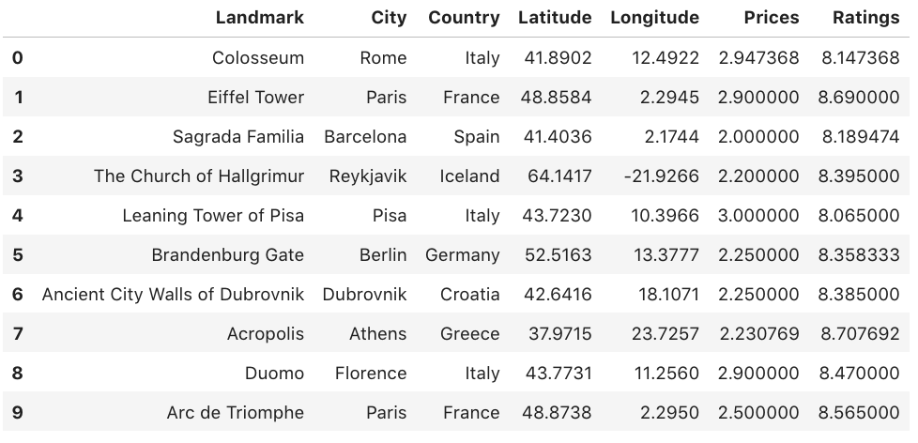

Inferential Statistics Testing Landmark details
To validate the averaging of rating and price information we view the results of the average of a number of cities prior to grouping
The prices reflected the fact that there are a limited number of tiers
The ratings likewise reflect that ratings are predominantly above 8 (which will cause a normalization requirement later)

Slide 16
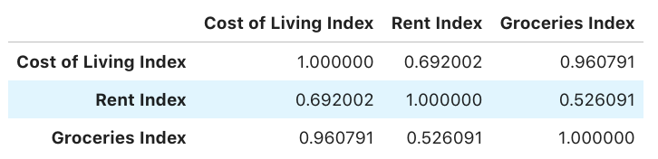
Inferential Statistics Testing City details
To validate the features being used for city details correlation details were generated as follows
The conclusion was that the ‘Groceries index’ could be removed as it correlated almost perfectly with the ‘Cost of living Index’

Slide 17
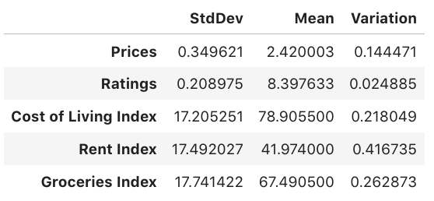
Inferential Statistics Testing Normalization
In order to validate the use of the differing statistics (and any potential requirement for normalization) the feature variations were calculated.
Although k-Means normalises to the mean of features passed, the variations above indicate that Ratings (and to some extent Prices) will effectively be given less ‘weight’ (due to the small Variation) .
Given this we clearly need to do some normalization before clustering.

Slide 18
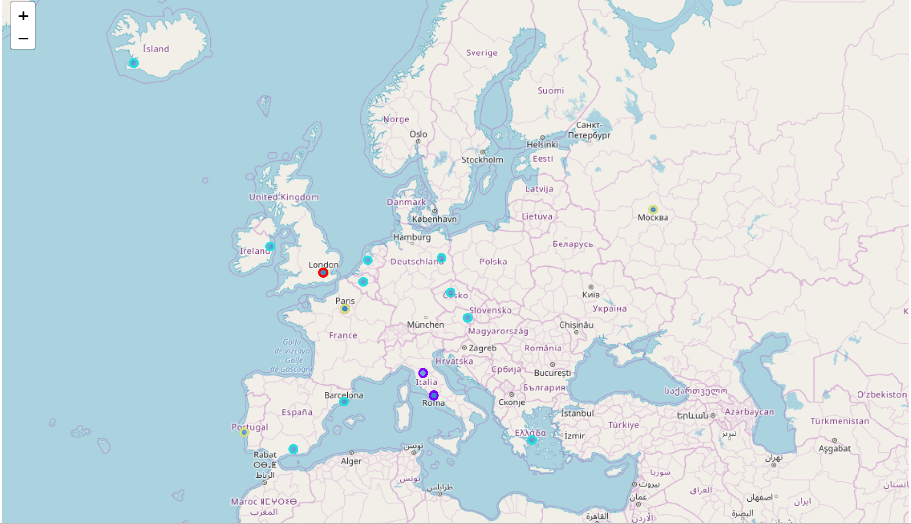
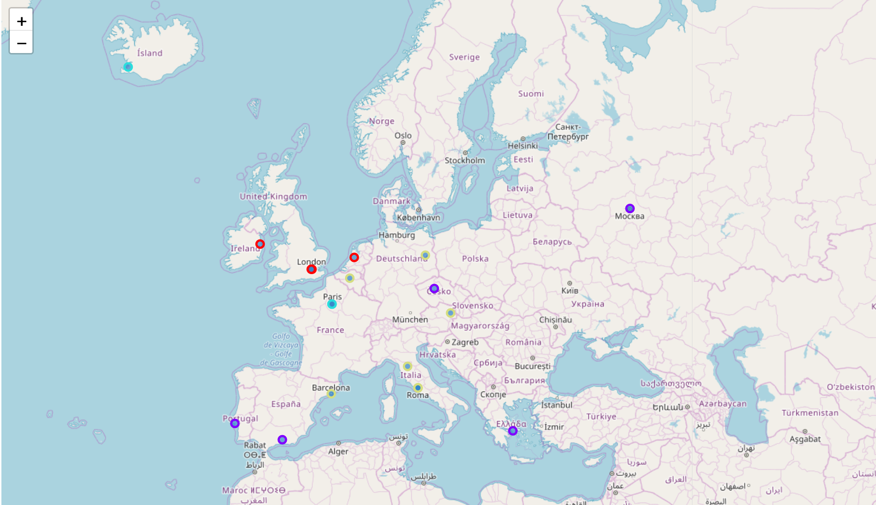

Machine Learning
In order to provide quick feedback a clustering algorithm was applied with and without the socio-economic information.
A change in cluster based on the addition of socio-economic information is a quick indicator of landmarks for potential development.
This approach would also provide for ease of visual change identification across time-series analyses in the future.

Slide 19
Results
Conveying information and diving on the details.

Slide 20
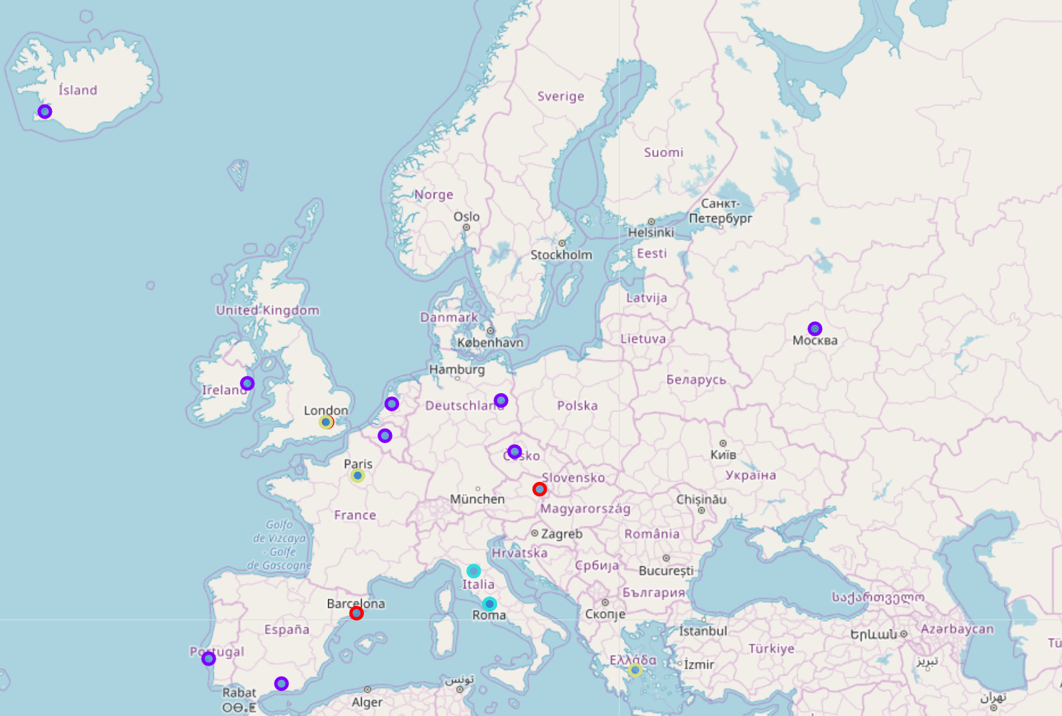

Initial clustering

Slide 21
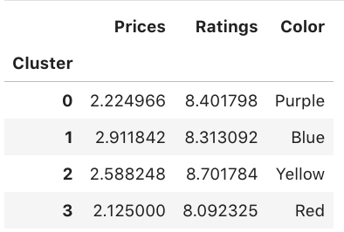

The meaning of colour
Clustering makes no judgement on the nature of the clusters, as it concentrates only on proximity. However as we want to eventually provide some qualitative feedback, it is worth analysing averages of the clusters, to see what they may imply.
Red – Low Price, Low Rating
Purple – Low Price, Medium Rating
Yellow - Medium Price, High Rating
Blue – High Price, Medium Rating

Slide 22

Notes on Displaying Results
Cluster Colour across multiple different clusterings
Clustering is not an ordered display, but we want to be able to relate two different clusters, so that most landmarks appeared in the same colour.
This is important as presenting visual feedback is the key goal of this investigation.
For this reason, manual colour selection based on analysis of landmarks in ‘key’ cities was applied to the second cluster display.

Slide 23
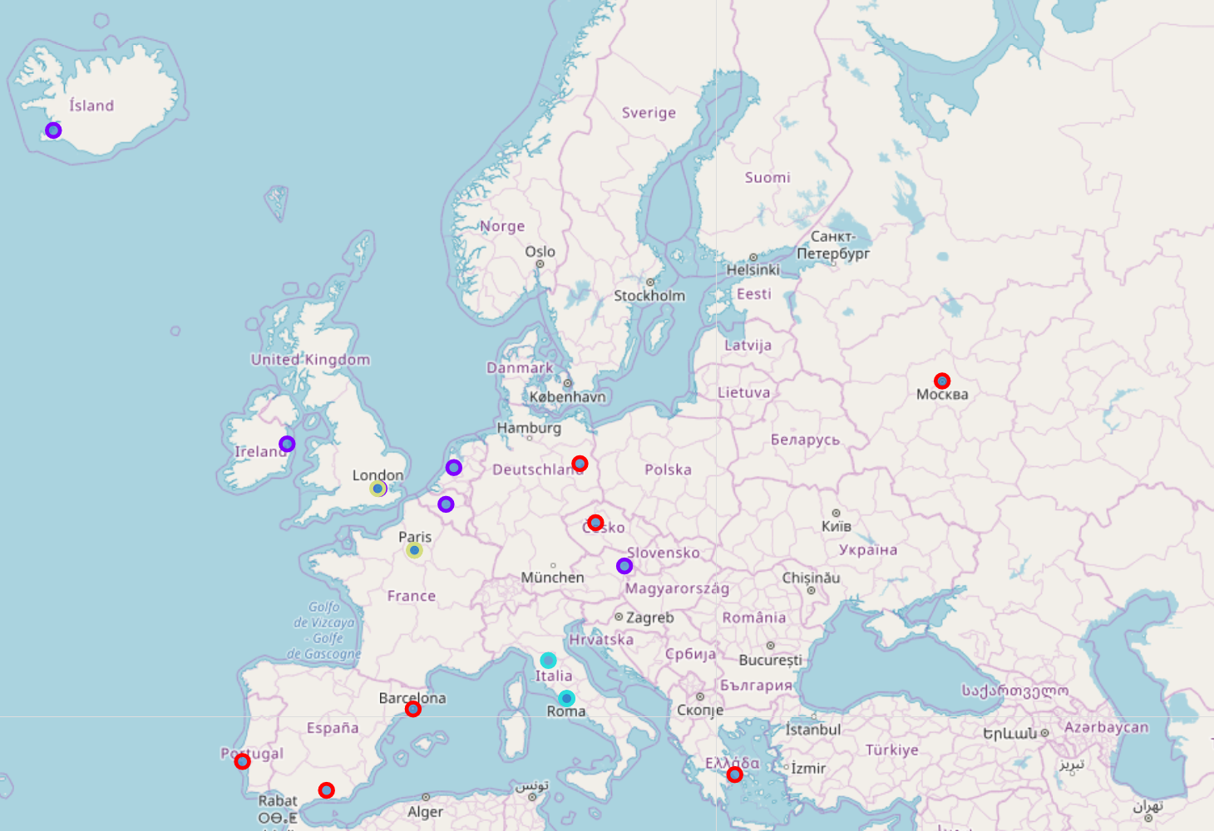
Socio-economic clustering

Slide 24
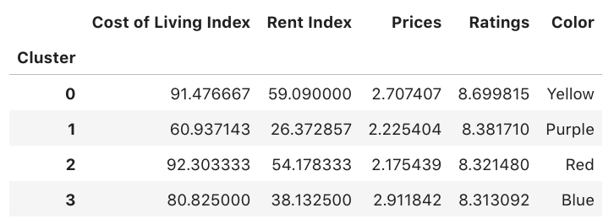
The meaning of colour
Again clustering makes no judgement on the nature of the clusters, however despite the increased number of features, we should look for some common indicators based on the cluster averages.
Red – High cost of living, Low Price and Rating
Purple – Low cost of living, Low Prices, high to medium ratings
Yellow - High price and rating, High cost of living
Blue – High prices, low to medium cost of living

Slide 25

Notes on Socio-economic Clustering
Changes in colour
Despite updating the cluster colours so that reference landmarks remain unchanged (in London, Paris and Rome for example) there are a significant number of changes in the cluster visible when socio-economic information is added
Key landmarks affected
Brandenberg Gate, Berlin (Purple to Red )
Charles Bridge, Prague (Purple to Red )
Schonbrunn Palace, Vienna (Red to Purple )
Alhambra, Granada (Purple to Red )
Belem Tower, Lisbon (Purple to Red )
Red Square, Moscow (Purple to Red )
Acropolis, Athens (Yellow to Red )
Big Ben, London (Required map zoom, Red to Purple )

Slide 26
Identifying potential development targets
Landmarks identified by cluster
Blue landmarks (in the second map) represent expensive well rated locations with a low cost of living (and therefore likely low overheads)
Four landmarks therefore standout as likely targets for development
Il Duomo, Florence
Trevi Fountain, Rome
Pantheon, Rome
Collisseum, Rome
The above makes sense as Italy is a treasure trove for tourists, but maintains a relatively low cost of living.

Slide 27
Identifying potential development targets
Landmarks identified by moving cluster
Unfortunately no Landmark moved into Blue or even Yellow (the best targets) and in fact most moved into Red (the worst combination of Price and Cost of Living)
However Price is not very reliable (as it appears too normalized across countries - see Discussion), so it may be worth looking at the landmarks who have at least moved from Red to Purple.
Schonbrunn Palace, Vienna
Big Ben, London
Of the above, Big Ben is the most interesting, as it consistently clusters differently to Buckingham Palace which is quite close. This is as opposed to Landmarks in Paris and Rome, which tend to cluster together.

Slide 28
Discussion
Observations and recommendations.

Slide 29
Notes on Initial Clustering
Clusters
Clustering of landmarks was not as expected, as it appears that that ratings and price index is not absolute, but is in fact normalised across cities (Dublin, Amsterdam and Moscow are unlikely to share similar prices and recommendations in absolute terms).
As we are looking for changes as a result of the addition of socio-economic information (rather than absolute results), we are somewhat insulated from this, but will need to return to it before drawing conclusions.
Multiple landmarks in a single city
The resolution can only display a single city colour, however we can always zoom in the case where required.
As it turns out (see previously) only Big Ben in London changes cluster. The multiple landmarks in Rome and Paris all remain consistent.

Slide 30
Potential changes to colour and cluster meaning
It’s worth looking at the changed meaning of the cluster, in case it’s actually one of our ‘key’ landmarks (that we kept static for colour) that has actually changed.
Red –
Was : Low Price, Low Rating
Is now : High cost of living, Low Price and Rating
Purple –
Was : Low Price, Medium Rating
Is now : Low cost of living, Low Prices, high to medium ratings
Yellow
Was : Medium Price, High Rating
Is now : High price and rating, High cost of living
Blue
Was : High Price, Medium Rating
Is now : High prices, low to medium cost of living
In this case it looks like the clustering remained reasonably consistent for our key Landmarks

Slide 31
Methods used
The Clustering strategy offered 2 insights into potential development opportunities
Clustering of restaurant data with socio-economic data
This provided very clear clusters whose averages in terms of price and cost of living were clearly different, and who therefore provided an excellent indicator for development opportunities.
Cluster changes with and without socio-economic data
As the price indicator appeared to be normalized across countries, the change in cluster were leass meaningful than anticipated, however some useful poiniters were extracted.

Slide 32

Futures
Time series animation
Time series information is available for much of the data included (both city and FourSquare)
Displaying changes to the clustering over time would give a good indicator as to the development ‘momentum’ for each landmark
Additional features
As new data becomes available it would be easy to add more features and cluster more accurately according to desireability of development

Slide 33
Conclusion
What we’ve learned

Slide 34

Results
Clustering can provide a very quick visible feedback that in our case helped identify the Landmarks with potential development opportunity
Il Duomo, Florence
Trevi Fountain, Rome
Pantheon, Rome
Collisseum, Rome
Big Ben, London
However its strength is quick assessment in this case and other (more straightforward) analyses would likely provide more detail, so is should likely be used best as a ‘first phase’ to identify areas for further analysis.

Slide 35

Improvements
The intial Pricing data from FourSquare may need further analysis as it doesn’t seem to give us the ‘likely profit indicator’ we were looking for as it appears normalized by country (i.e. expensive for this country rather than just expensive). The fact that the rating is just 1-4 also gives little room for accuracy
The initial Rating data from FourSquare was used to indicate positive customer experiences (and therefore likely a growing business area) but this association is vague and could do with further analysis.
Cost of living is just one indicator as to the Cost of doing business. Others (such as tax and overheads) should be added for greater accuracy.

